Slide 1

Anomaly Detection in Lymphoma Patients
Lin Burg & Tamar Shnirer

Slide 2
Outline
Introduction
Goal
Challenges
Process
Final Product
Findings & Conclusions

Slide 3
Introduction
Lymphoma is a group of blood malignancies that develop from lymphocytes.
Diffuse large B-cell lymphoma (DLBCL) is an aggressive type of Lymphoma that develops from the B-cells in the lymphatic system.
Often the first symptom of DLBCL is a painless swelling in the neck, armpit or groin that is caused by enlarged lymph nodes. These lumps can grow quite quickly, often over a period of a few weeks. Sometimes, other parts of the body are also affected. This is known as ‘extranodal’ disease because it is happening outside of the lymph nodes.

Slide 4
Introduction
Our Goal
We were given a data set of 516 observations describing a patient with DLBCL.
The dataset included 20 features and we needed to consult a medical doctor in order to have a deeper understanding of the meaning of every feature.
To get rid of outliers in the most efficient way so we can develop the optimal classifier whether the patient has extranodal sites or not.

Slide 5
Challenges
Understanding medical data and the possible range of values per feature
Missing data & probable outliers due to data-entry errors (out of range of the medical staging method) -
e.g., IPI Range - a value between 1-5 (some values in the data: 23, 45, 24…)
Almost 25%(!!) of our observations didn’t have label
Developing an easy-to-implement decision support system for the medical staff
We consulted a MD in order to have better understanding of the meaning of the features
Fixed illogical values after advising with an expert
We imputed some values based on other features and used the median value for imputation of features we didn’t have much knowledge about
We trained our model on the labeled observations only and then we added our unlabeled observations
Developing 2 models: a more complex one to achieve the best results possible, and an easy-to-use rule-based Decision Tree
Developing a user-friendly tool for data-entry & prediction

Slide 6
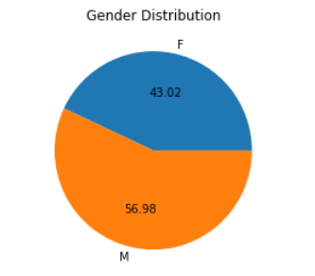
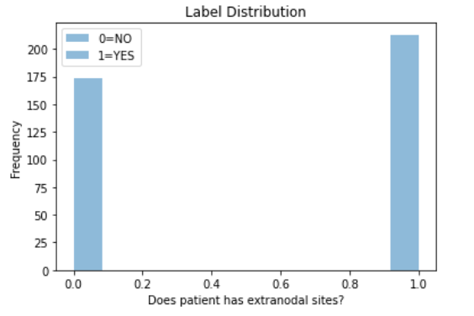
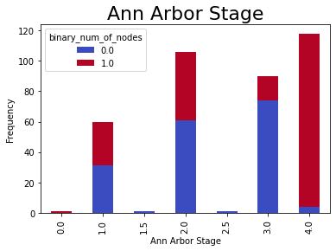
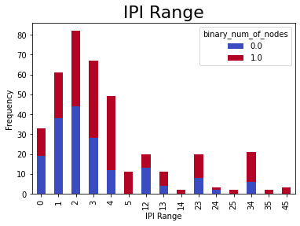
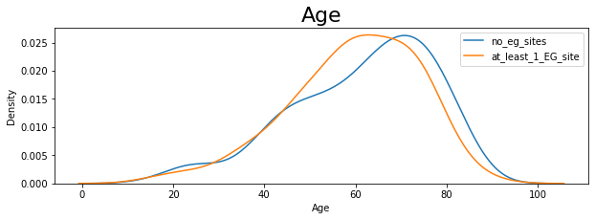
Process - Data Exploration
Fairly balanced dataset
Ann Arbor Stage & IPI Range could act as strong indicators for prediction (also age*)

Slide 7
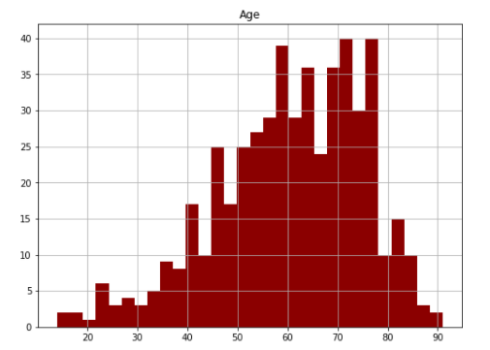
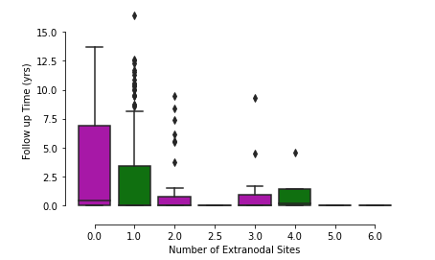
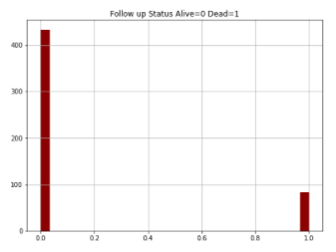
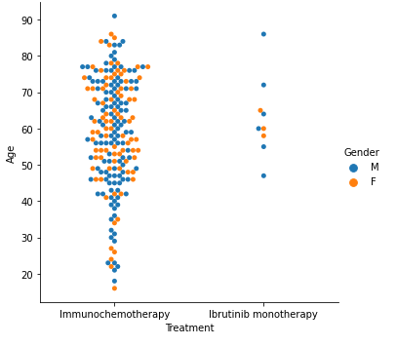
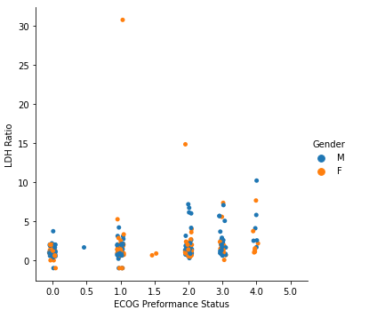
Process - Data Exploration
Data Exploration

Slide 8
Process - Data Preprocessing Pipeline (using transformer_mixin class)
Initial Preprocessing
Drop irrelevant columns
Map Boolean values to 1/0
Map label to 1/0
Numeric Transformer
Impute missing values using median
Category Transformer
Impute missing values as ‘unknown’
OHE Encoding
IPI Transformer
Fix IPI Range values
Complete IPI_group using IPI Range
Extract Min, Mean, Max values
MinMax Scaler
Outlier Detection
More details in the next slides :)
Modelling

Slide 9
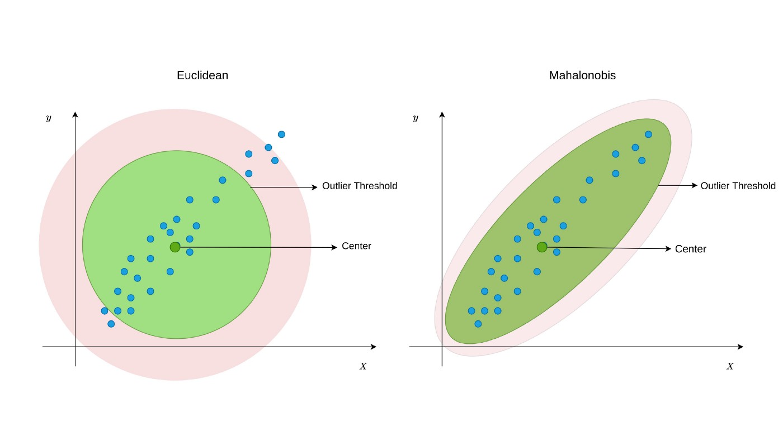
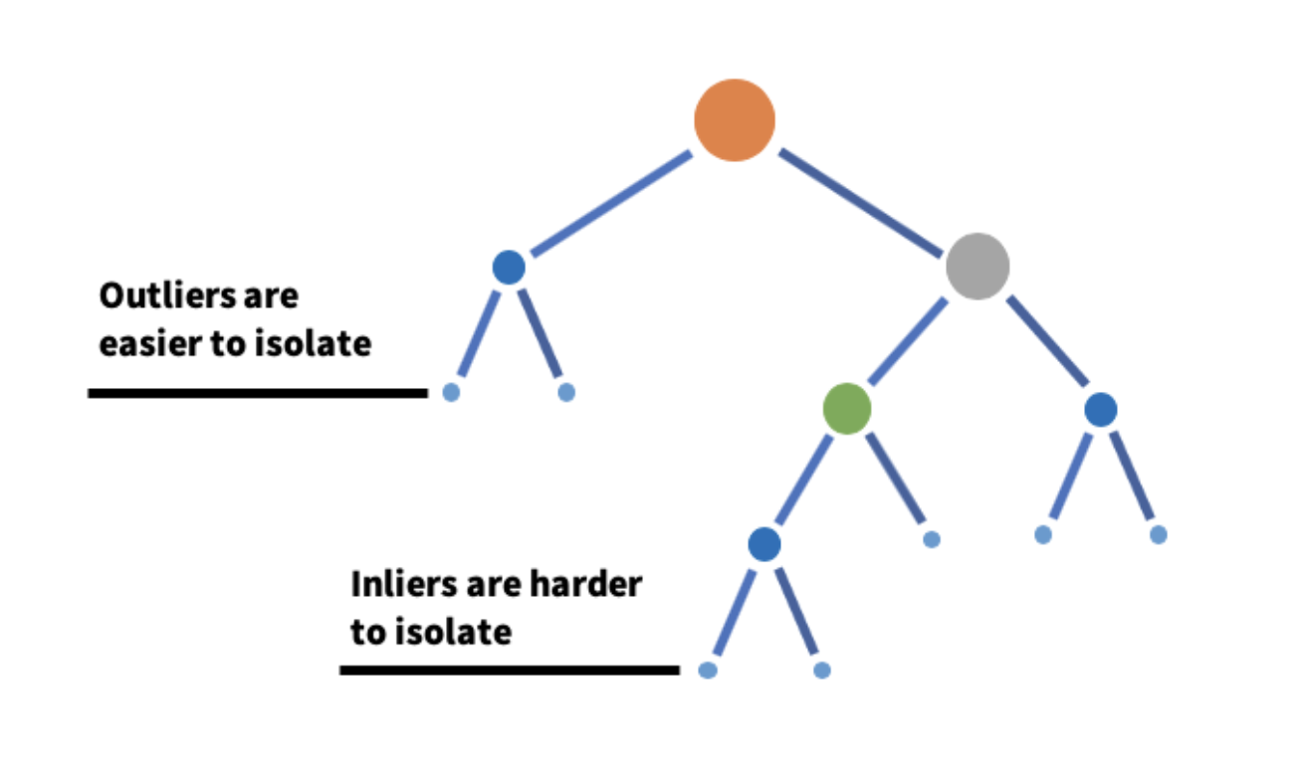
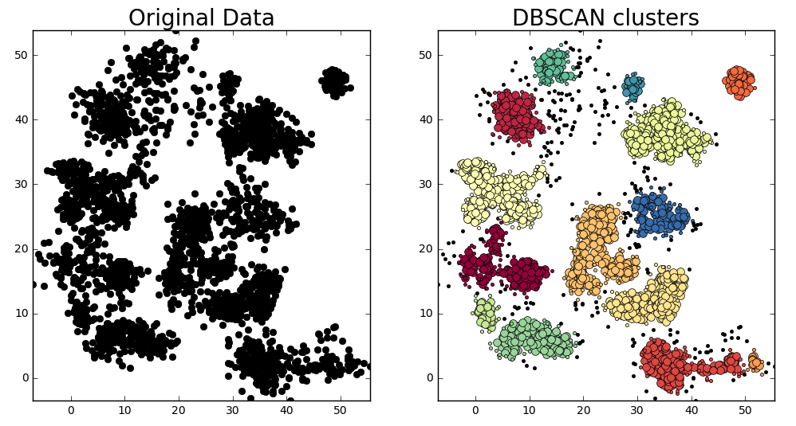
Outlier Detection Methods
Minimum Covariance Determinant - This model assumes that the features of the data are normally distributed. It uses Mahalanobis distance from each point to the mean, and defining anomalies as points with with distance above some threshold.
Isolation Forest - This unsupervised method is similar in principle to Random Forest in a way that it selects a feature and splits by it. Anomalies are identified by having shorter path lengths than other observations.
DBSCAN - A density-based clustering non-parametric algorithm: given a set of points in some space, it groups together points that are closely packed together. Points that do not belong to any cluster are defined as noise (outliers).
Notes:
Minimum Covariance Determinant - המודל מניח

Slide 10
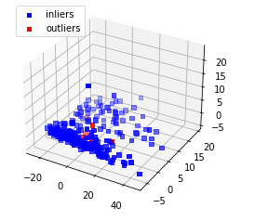
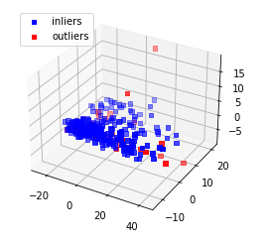
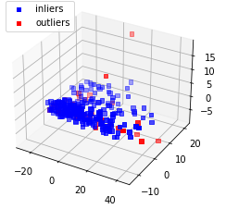
Outlier Model Testing
Minimum Covariance Determinant - We need to remove 8% of data as outliers in order to optimize our results to get 0.807 AUC score
Isolation Forest - We need to remove 4% of data as outliers in order to optimize our results to get 0.803 AUC score
DBSCAN - We need to remove ~11% of data as outliers in order to optimize our results to get 0.785 AUC score
Is Isolation Forest our best model?

Slide 11
Testing Feature Number X Classifier X Outlier Detection Method
The best classifier with outliers is Random Forest with 15 features which give us AUC score of 0.806.
The combination of classifier and anomaly detection method is Random Forest & MCD and 15 features which give us AUC score of 0.824.

Slide 12
Semi - Supervised labeling for the unlabeled rows
Using an iterative method called label propagation and for some probability threshold we:
1) Train RF classifier on the labeled training data.
2) Use the classifier to predict labels for all unlabeled data.
3) Concatenate the pseudo-labeled data with the labeled training data.
We stopped when there are no longer data points that we can classify by using our threshold.
After 4 iterations we managed to label 103 out of 129 unlabeled observations.

Slide 13
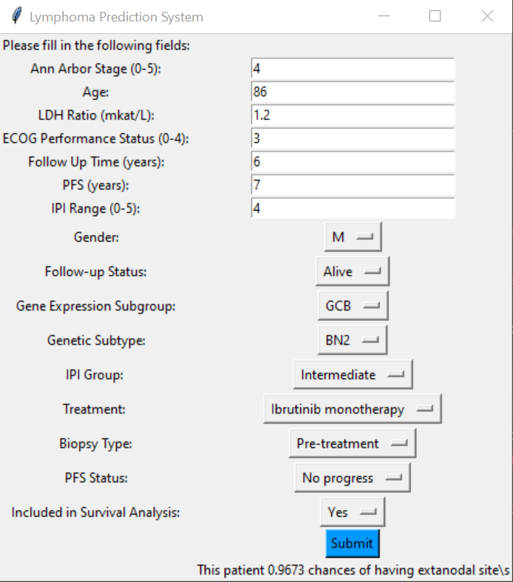
Final Product
We created a software with user-friendly interface for the doctor in order to make a decision-support system for the doctors.

Slide 14
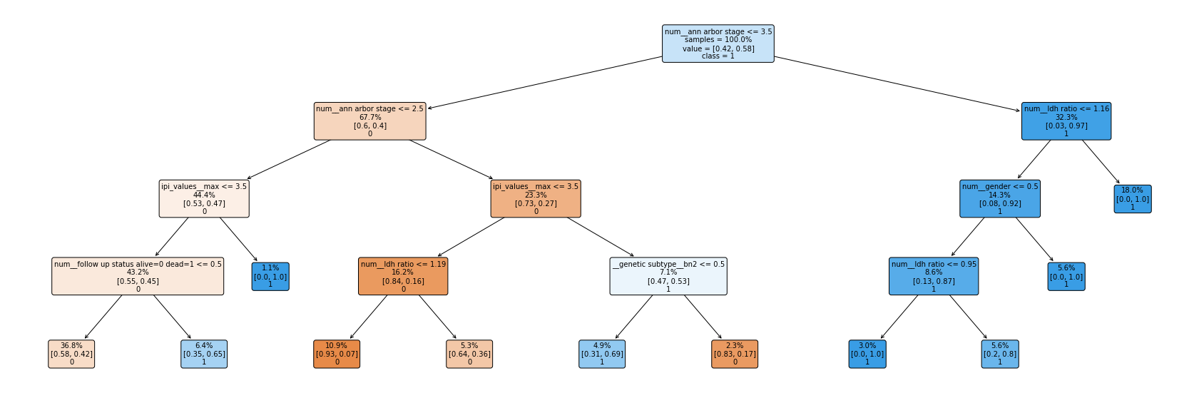
Final Product – Basic Rule-Based Model
In addition to the software, the MD staff can also use a much simpler model (below). It is meant to be used alongside the prediction presented in the software.

Slide 15
Conclusions & Discussion
Although we thought that isolation forest is the best outlier detection method, we reached even higher AUC by the combination of Random Forest & MCD and 15 features.
Our algorithm was trained on 500 cases only and is depended on specific features, it is depended on certain features and would not be suitable for every DLBCL case.
We tested only 3 outlier detection methods, there are many more methods that we could test so maybe there is a better method for our data.

Slide 16
Questions?

